Slide 1

Project Proposal Predictive Maintenance in Heavy Machinery: A Machine Learning Approach Using Vibration and Temperature Sensor Data
Course Title: MSc in Data Analytics
Lecturer Name: Dr. Anesu Nyabadza
Module/Subject Title: Advanced Research Methods
Date: 14th April, 2025
Student Name | Student ID
Avinash Virupaksh Desai | 20032381

Slide 2
Research Aim & Questions
Aim:
To explore ML techniques for predicting failures using sensor data in heavy machinery.
Research Questions:
Can ML models predict machine failure using sensor data?
How can vibration and temperature improve PdM systems?

Slide 3
Literature Insights & Techniques
IoT + ML: Real-time sensor data enables early fault detection (Madasamy et al., 2023).
Vibration Analysis: Useful in diagnosing imbalances or wear (Pavithra & Ramachandran, 2021).
Uncertainty-Aware DL: Improves trustworthiness of fault detection (Shao et al., 2023).
Hybrid Models: CNN + LSTM with Hilbert transform improves accuracy (Zabin et al., 2022).
Transfer Learning: Helps when failure data is scarce (Azari et al., 2023).

Slide 4
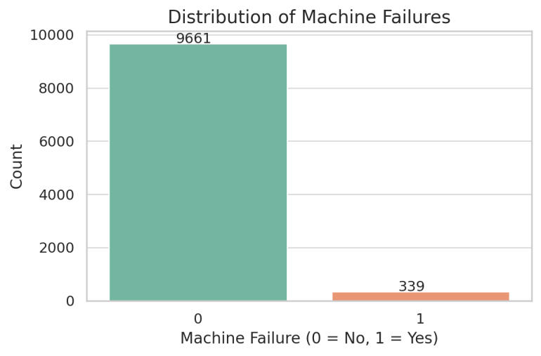
Methods and Dataset Overview
Dataset: AI4I 2020 — 10,000 samples, 14 features.
Failure Modes: Tool wear, heat dissipation, power, overstrain, random.
ML Approaches:
Supervised: Random Forest, SVM, Decision Tree
Unsupervised: K-means, Autoencoders
Deep Learning: CNN, LSTM
Transfer Learning used to overcome data limitations.

Slide 5
Metrics & Definition
Metric | Definition | Importance in PdM
Accuracy | (TP + TN) / Total | General performance indicator
Precision | TP / (TP + FP) | Important when false positives are costly
Recall | TP / (TP + FN) | Critical in minimizing missed failures
F1 Score | 2 × (Precision × Recall) / (Precision + Recall) | Balance between precision and recall
ROC-AUC | Area under ROC curve | Assesses model’s ability to distinguish classes

Slide 6
Findings and Future Directions
ML models can detect failures with high accuracy.
Vibration & temperature sensors are strong predictors.
Transfer learning improves generalization.
Challenges: Data scarcity, high computational cost, domain shifts.
Future Work:
Modeling and Evaluation of ML model
Use multi-source TL.

Slide 7
References
Azari, M.S., Flammini, F., Santini, S. and Caporuscio, M. (2023) ‘A systematic literature review on transfer learning for predictive maintenance in Industry 4.0’, IEEE Access, 11. Available at: https://doi.org/10.1109/ACCESS.2023.3239784
Madasamy, S., Shankar, B.P., Yadav, R.K. and Jayalakshmi, K.P. (2023) ‘A machine learning approach in predictive maintenance in the IoT enabled Industry 4.0’, in Proceedings of the 4th International Conference on Smart Electronics and Communication (ICOSEC 2023), pp. 418–423. Available at: https://doi.org/10.1109/ICOSEC58147.2023.10276226
Pavithra, R. and Ramachandran, P. (2021) ‘An overview of predictive maintenance for industrial machine using vibration analysis’, in 3rd IEEE International Virtual Conference on Innovations in Power and Advanced Computing Technologies (i-PACT 2021). Available at: https://doi.org/10.1109/i-PACT52855.2021.9696751
Singgih, M.L., Zakiyyah, F.F. and Andrew (2024) ‘Machine learning for predictive maintenance: A literature review’, in 2024 7th International Conference on Vocational Education and Electrical Engineering (ICVEE 2024): Charting the Course of Artificial Technology in Sustainable Society, pp. 250–256. Available at: https://doi.org/10.1109/ICVEE63912.2024.10823713
Zhang, N., Zhao, J., Ma, L., Kong, H. and Li, H., 2022. Tool wear monitoring based on transfer learning and improved deep residual network. IEEE Access. Available at: https://ieeexplore.ieee.org/document/9941668
Shao, H., Li, W., Cai, B., Wan, J., Xiao, Y. and Yan, S., 2023. Uncertainty-aware deep learning: A promising tool for trustworthy fault diagnosis. IEEE Transactions on Industrial Informatics. Available at: https://www.ieee-jas.net/article/doi/10.1109/JAS.2024.124290
Serradilla, O., Zugasti, E. and Zurutuza, U., 2020. Deep learning models for predictive maintenance: A survey, comparison, challenges and prospect. arXiv preprint arXiv:2010.03207. Available at: https://arxiv.org/abs/2010.03207
Samatas, G.G., Moumgiakmas, S.S. and Papakostas, G.A., 2021. Predictive maintenance—Bridging artificial intelligence and IoT. arXiv preprint arXiv:2103.11148. Available at: https://arxiv.org/abs/2103.11148
Zabin, M., Choi, H.J. and Uddin, J., 2022. Hybrid deep transfer learning architecture for industrial fault diagnosis using Hilbert transform and DCNN–LSTM. The Journal of Supercomputing. Available at: https://link.springer.com/article/10.1007/s11227-022-04830-8
Jiya, T., 2019. 'Ethical Implications of Predictive Risk Intelligence'. Centre for Computing and Social Responsibility, De Montfort University. ORBIT Journal, 2(2). Available at: https://doi.org/10.29297 /orbit.v2i2.112

